Slide 1
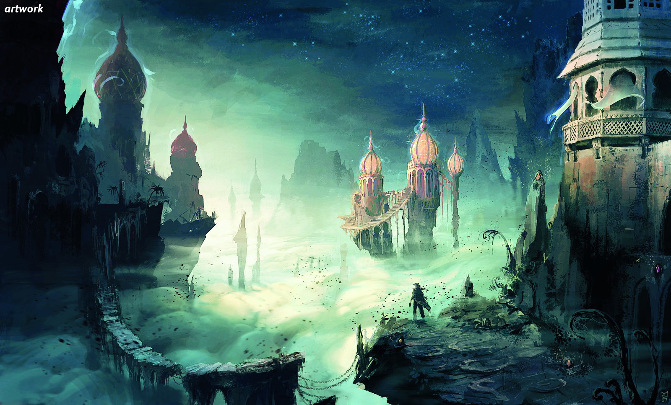
Persia (Iran)

Slide 2
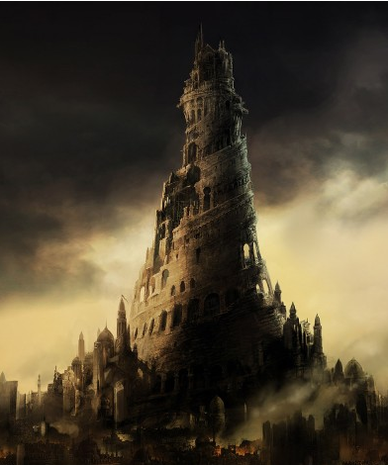
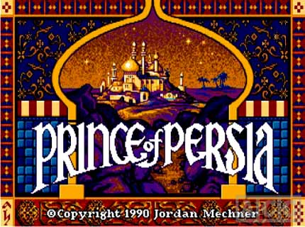
Persia?
Maybe you remember Persia form the game ☺ ; Prince of Persia

Slide 3
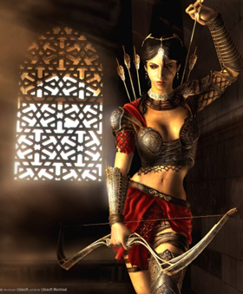
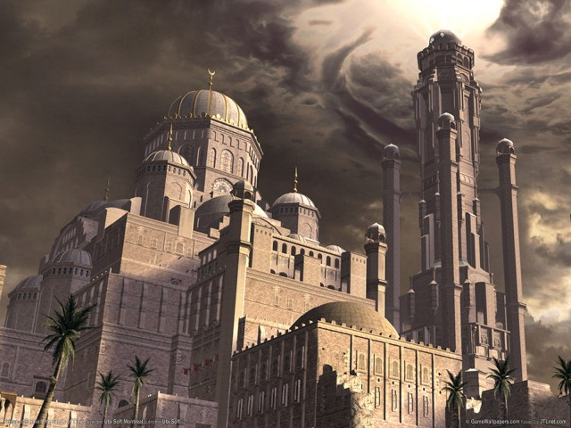
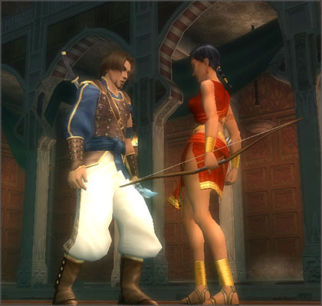
Prince of Persia

Slide 4
Persia?
Maybe you remember Persia form the game ☺ ; Prince of Persia

Slide 5
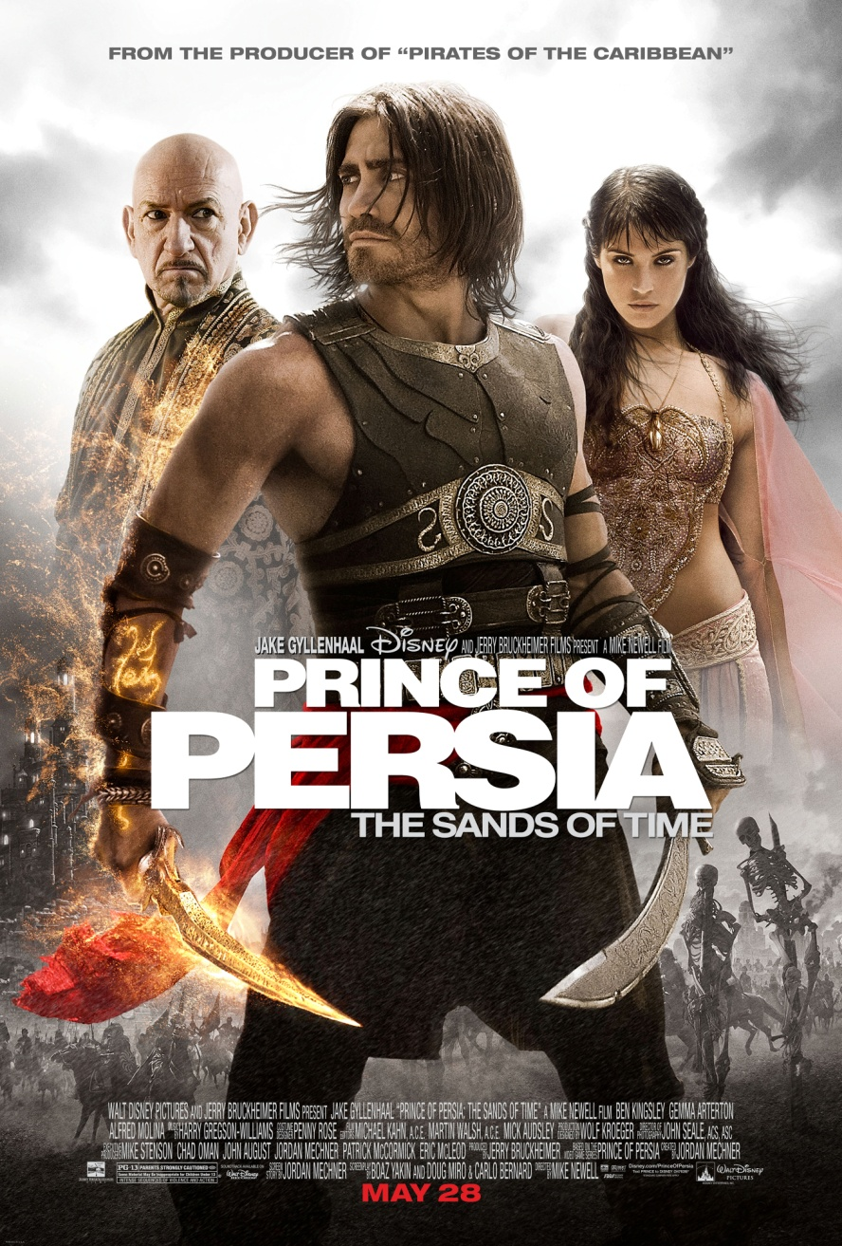
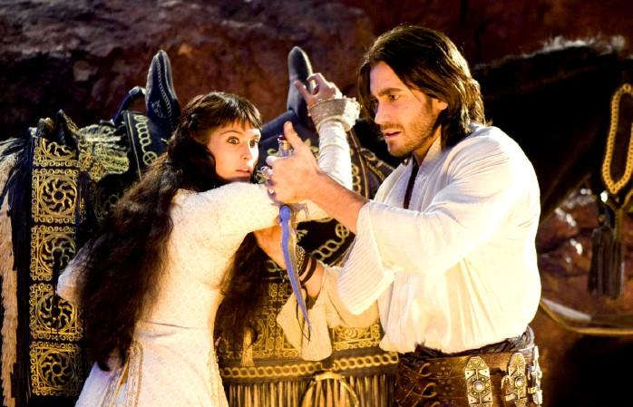
Or maybe it reminds
you the recent Disney’s movie
Prince of Persia
You can find its trailer in
youtube.com.

Slide 6
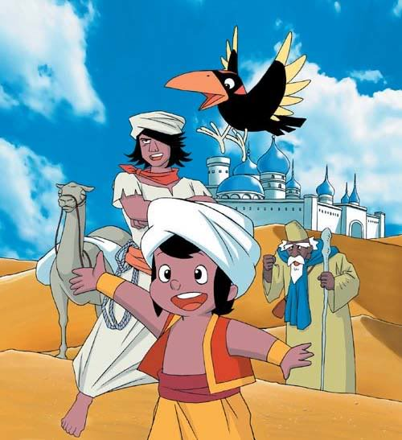
Or some nice stories from childhood :
One Thousand and one nights
Ali baba
& 40
thieves
or
Sinbad !

Slide 7
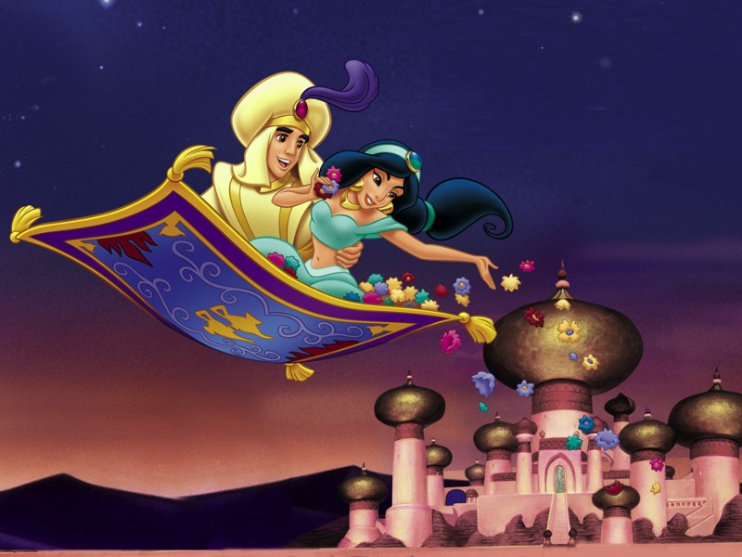
One Thousand and one nights
Alladin !

Slide 8
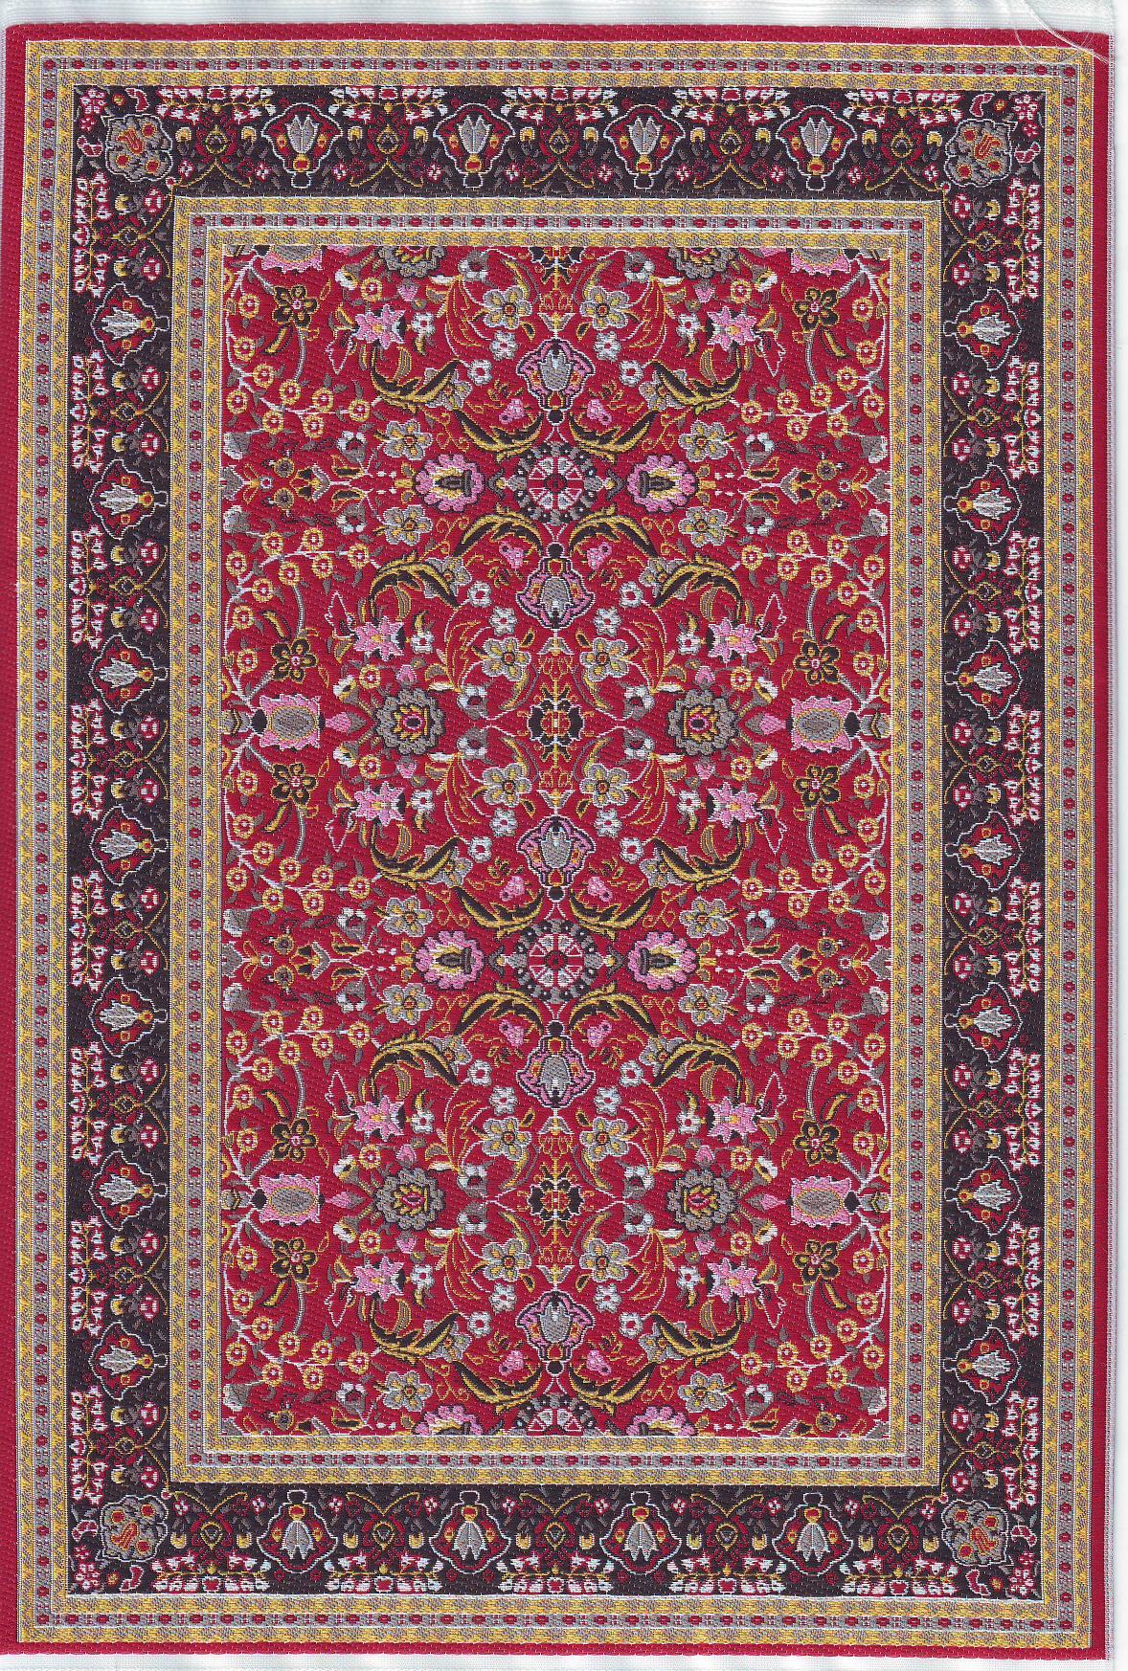
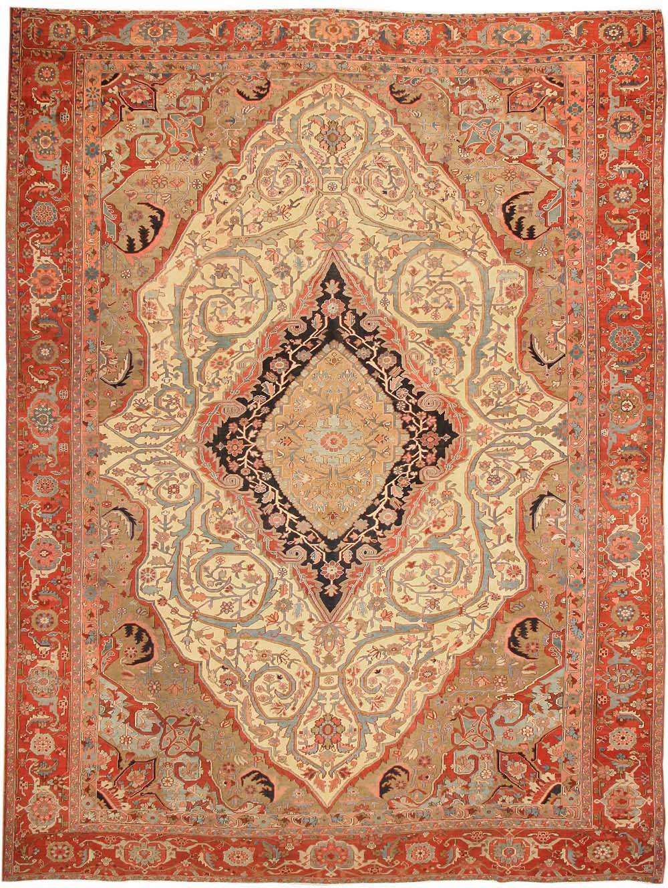
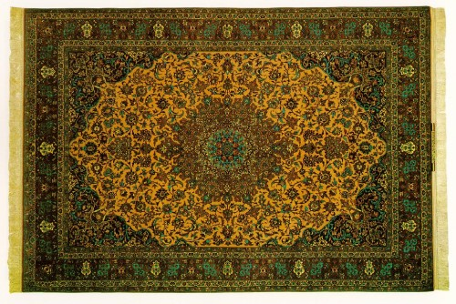
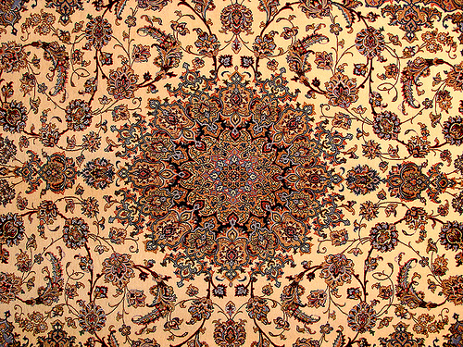
Persian Carpets!
Or the beautiful and expensive carpet at your home ☺

Slide 9
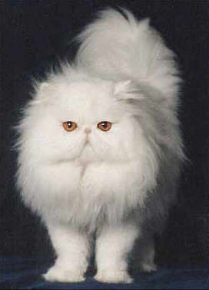
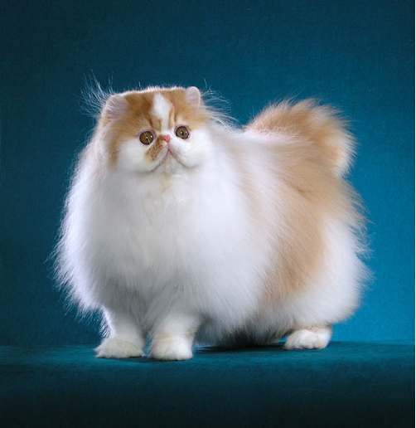
Persian Cats

Slide 10
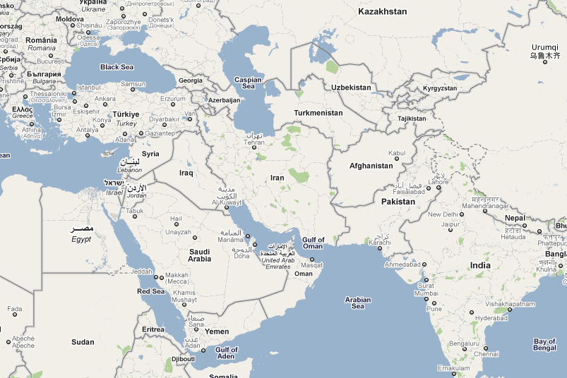
Iran: Geographical Situation

Slide 11
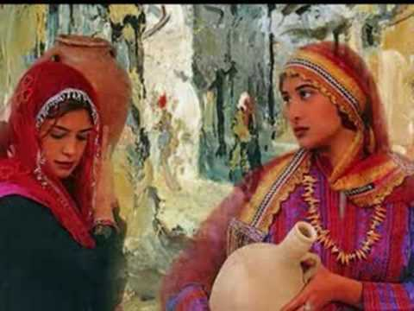
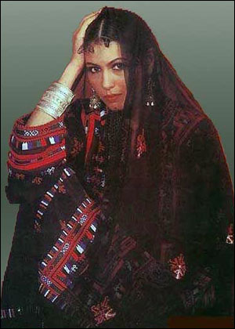
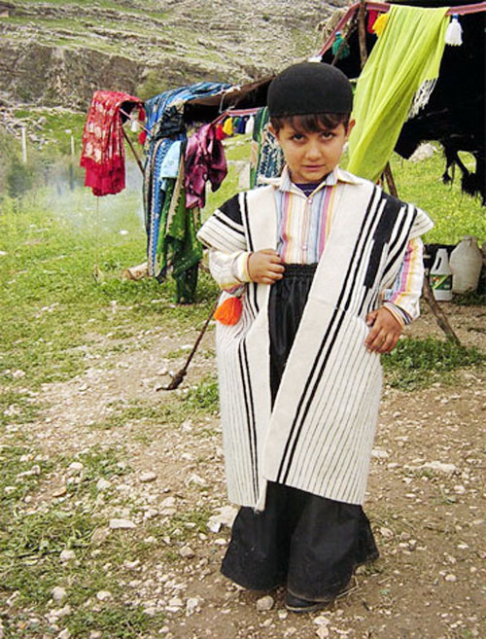
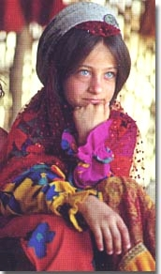
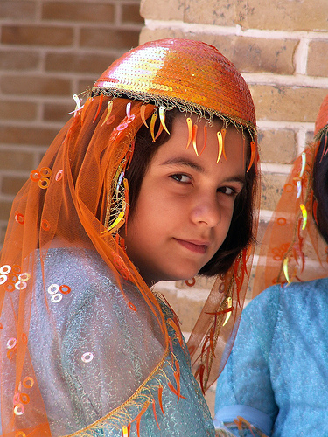
Ethnic People
Most of Iranian are Persians .
Also Armenian, Assyrian, Azeri, Kurdish, Luri, Balochi, Arabic, Turkmen

Slide 12
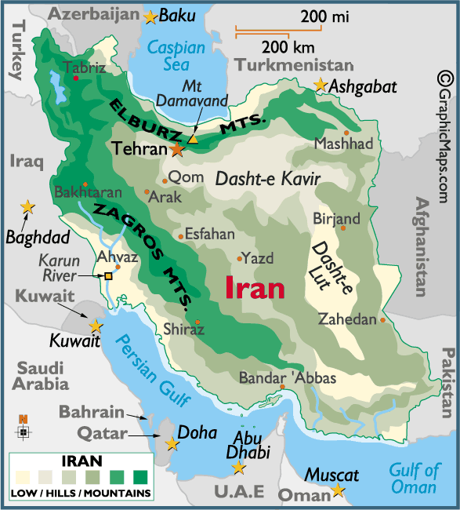
Nature

Slide 13
Highest Mountain 5675m

Slide 14
North of Iran

Slide 15
North of Iran

Slide 16
North of Iran

Slide 17
West of Iran

Slide 18
Desert (Lut) south-east

Slide 19
East of Iran

Slide 20
Iran Big desert (Kavir)

Slide 21
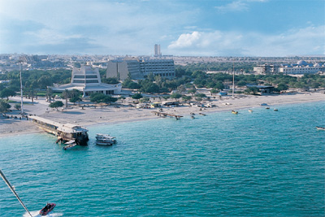
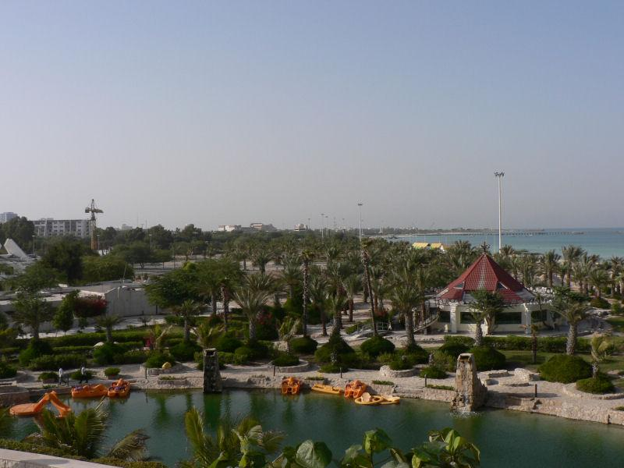
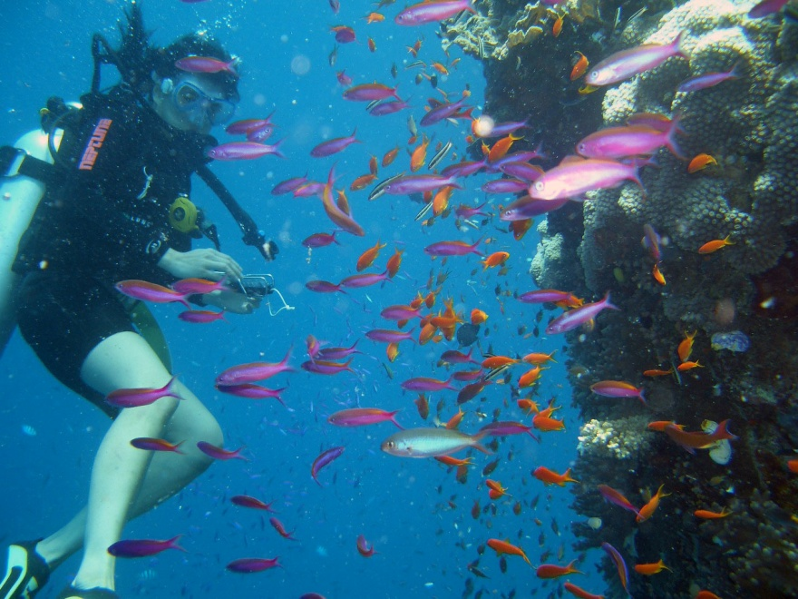
Persian Gulf
Islands

Slide 22
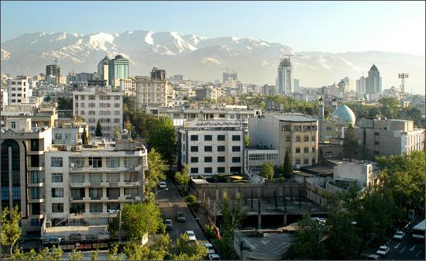
Iran Cities
Tehran (capital) 8,000,000 papulation

Slide 23
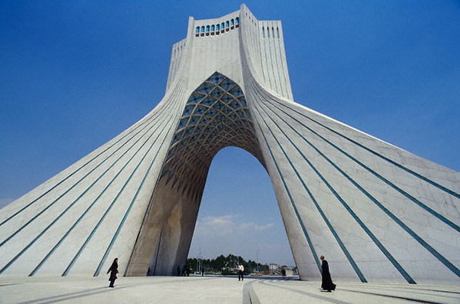
Tehran (Liberty Square)

Slide 24
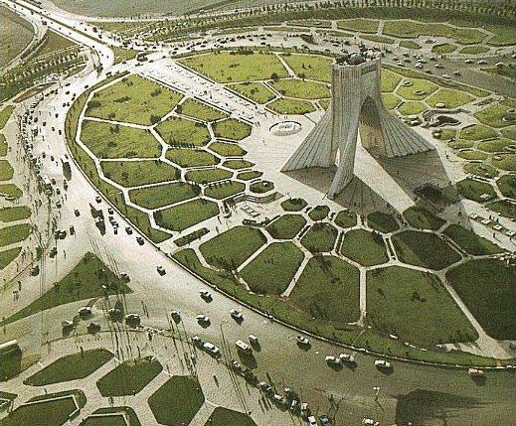
Tehran (Liberty Square)

Slide 25
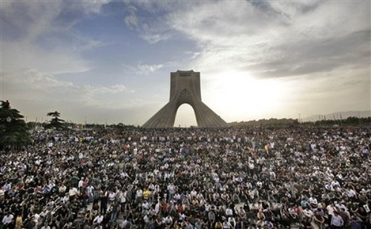
Square of memories

Slide 26
Iran Main Cities
Isfahan (Cultural capital)
2,000,000 papulation
It was capital of persian empire
350 years ago!

Slide 27
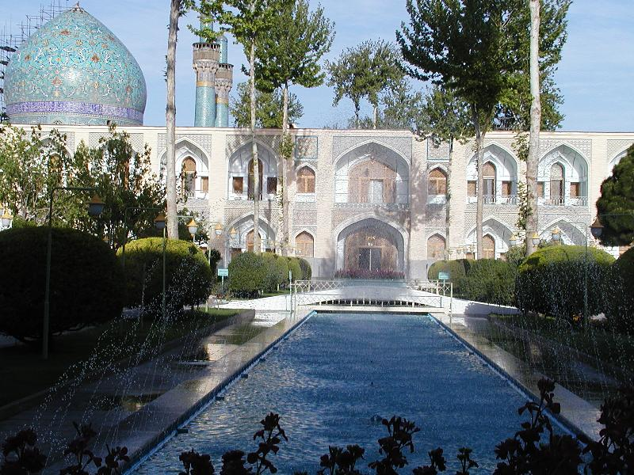
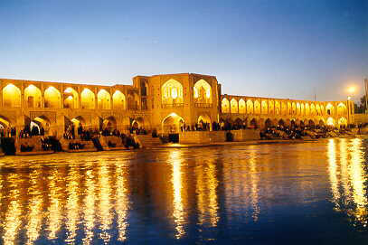
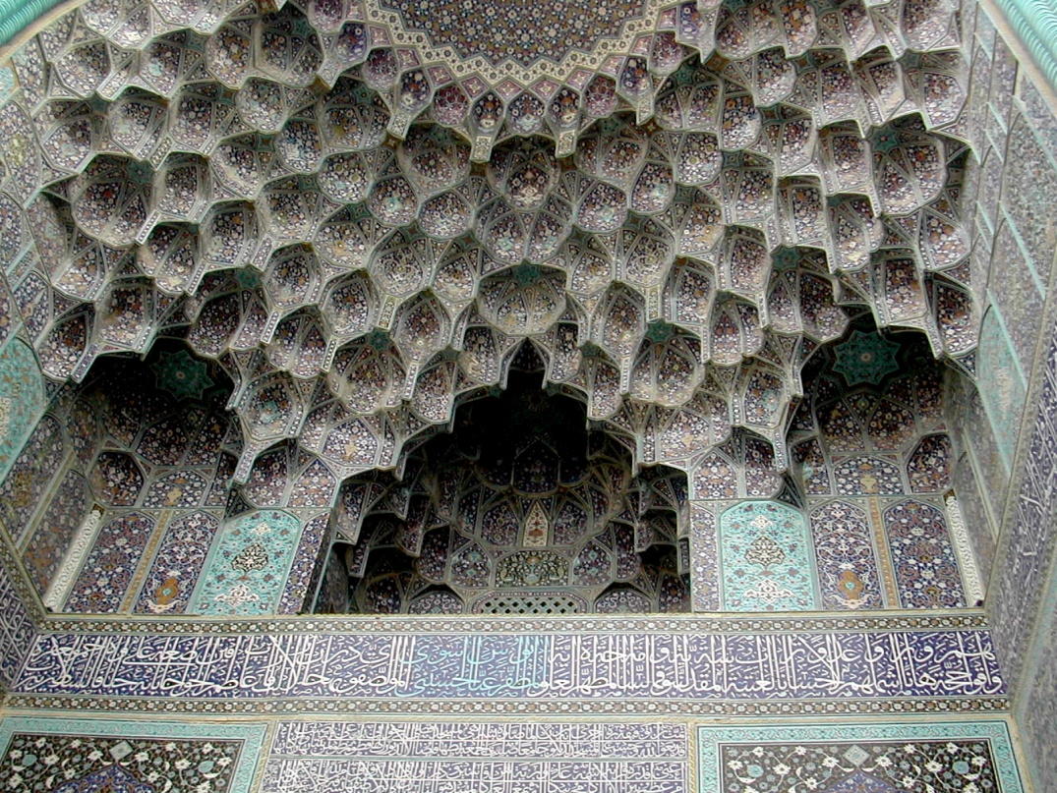
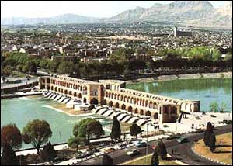
Isfahan

Slide 28
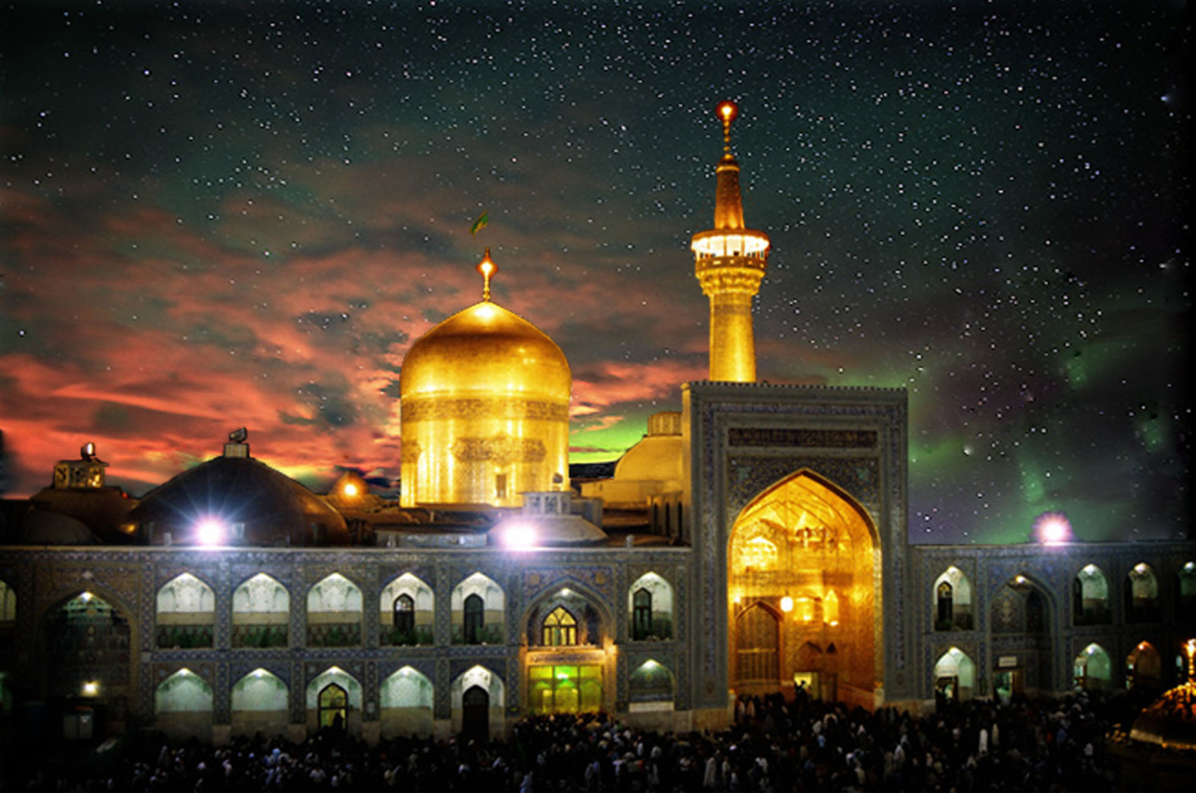
Iran Cities
Meshad (Religious capital)
2,500,000 papulation

Slide 29
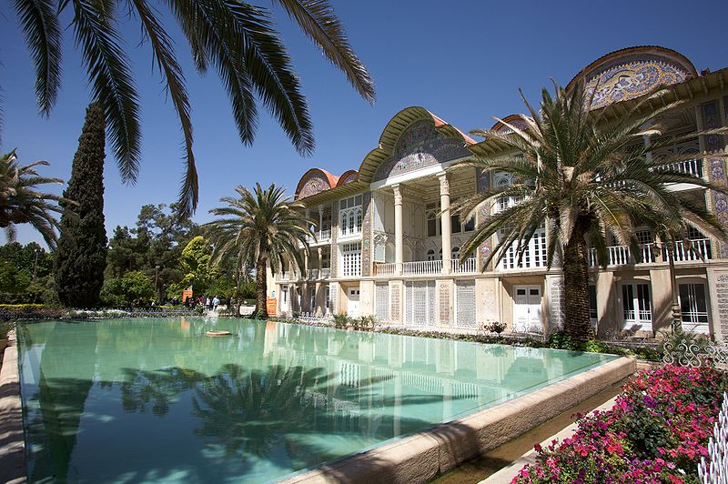
Iran Main Cities
Shiraz (Historical centure)
1,500,000 papulation

Slide 30
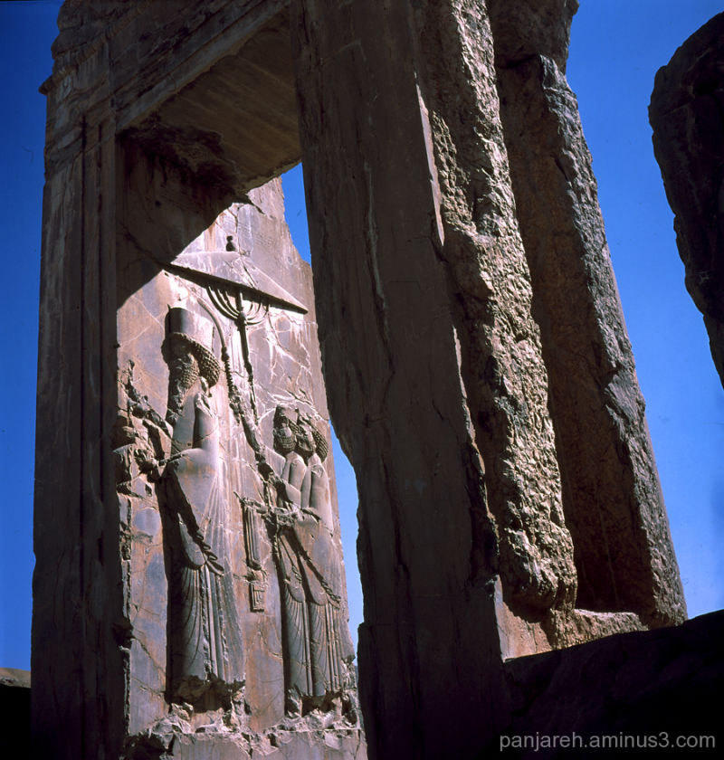
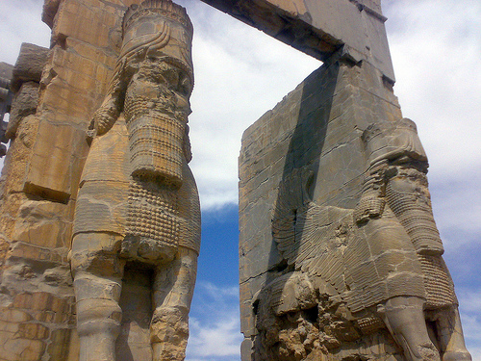
Perspolice
Persian Empire City site 2700 years ago

Slide 31
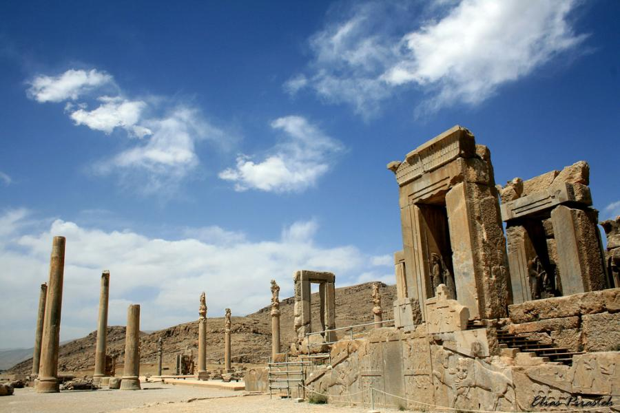
Perspolice

Slide 32
There are a lot like…
Persian Music
Persian Dance
Persian Food
And …..

